Slide 1
CHAPTER 9.1:
INORGANIC CHEMISTRY
(CHEMICAL PERIODICITY)

Slide 2
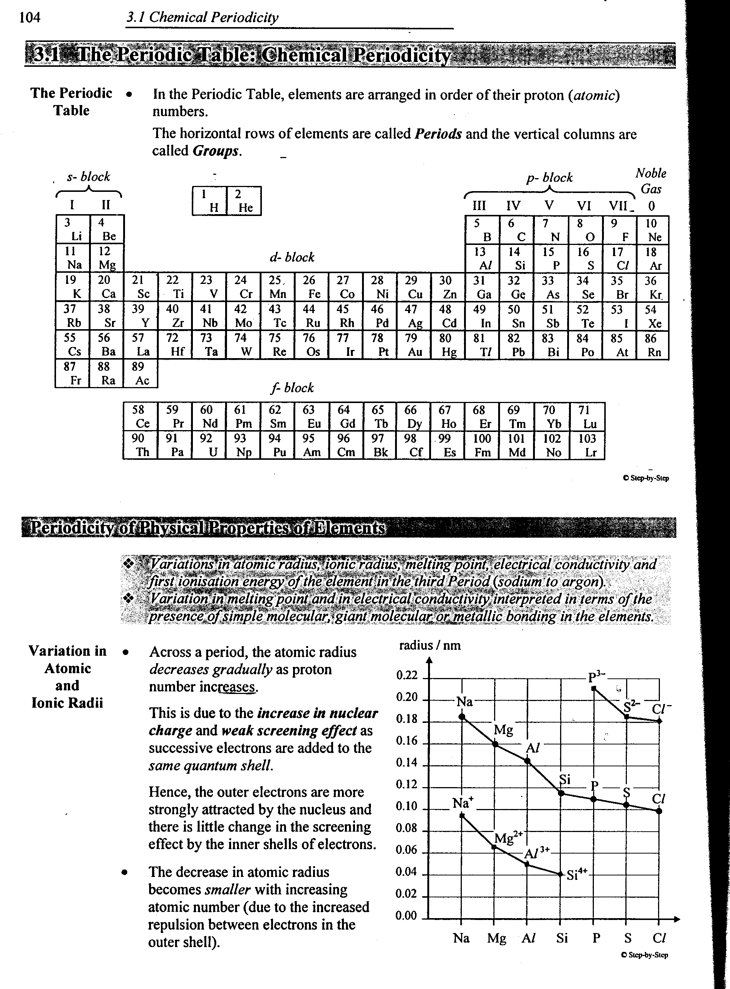
Periodic Table

Slide 3
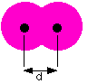
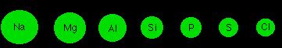
Physical Properties
Variation in Atomic Radii
Atomic radius - defined as half the internuclear distance between two like atoms bonded only by a single bond.
Across a period, the atomic radius decreases as proton number increases - result in the increase in nuclear charge.
Radius= d/2

Slide 4
Physical Properties
Variation in Atomic and Ionic Radii
Cations are smaller than their respective atoms
Anions are bigger than their respective atoms
Anions are bigger than cations from the same period.
In an isoelectronic series(Na⁺ to Si⁴⁺ and P³⁻ to Cl⁻), the ionic radius decreases as the proton number increases. Because attraction between the outermost electron and nucleus increases.

Slide 5
Physical Properties
Variation in Atomic and Ionic Radii

Slide 6
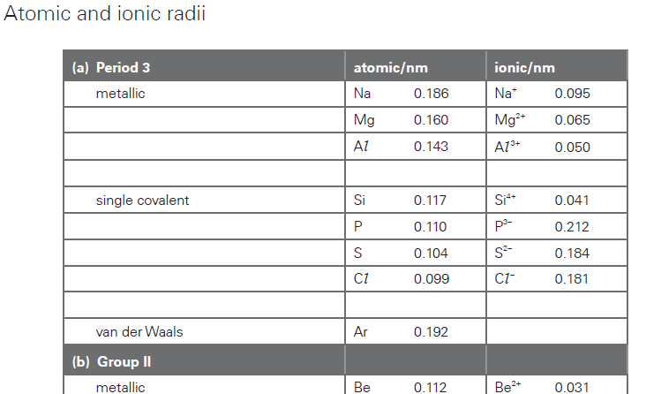
Data Booklet

Slide 7
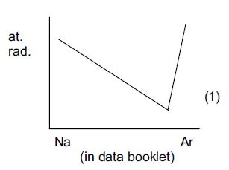
Atomic Radius

Slide 8
Physical Properties
Variation in Melting Point
Melting involves seperatingt he particles from solid to liquid.Hence, the m.p. of an element indicates the strength of forces holding the particles together in crystal lattice
Melting point increases from Na to Al as the strength of _______________ increases.
Si has very high m.p. due to its giant covalent structure(with strong covalent bond)
P, S, Cl and Ar have lower m.p. because they are simple molecules with weak VDW forces between molecules.

Slide 9
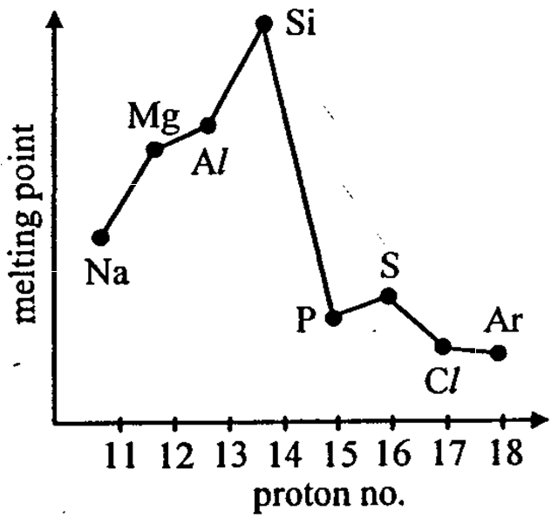
Physical Properties
Variation in Melting Point

Slide 10
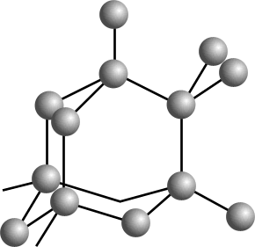




MELTING POINT TREND - NON METALS
P₄ S₈ Cl₂ Ar
melting point / K 317 392 172 84

Slide 11
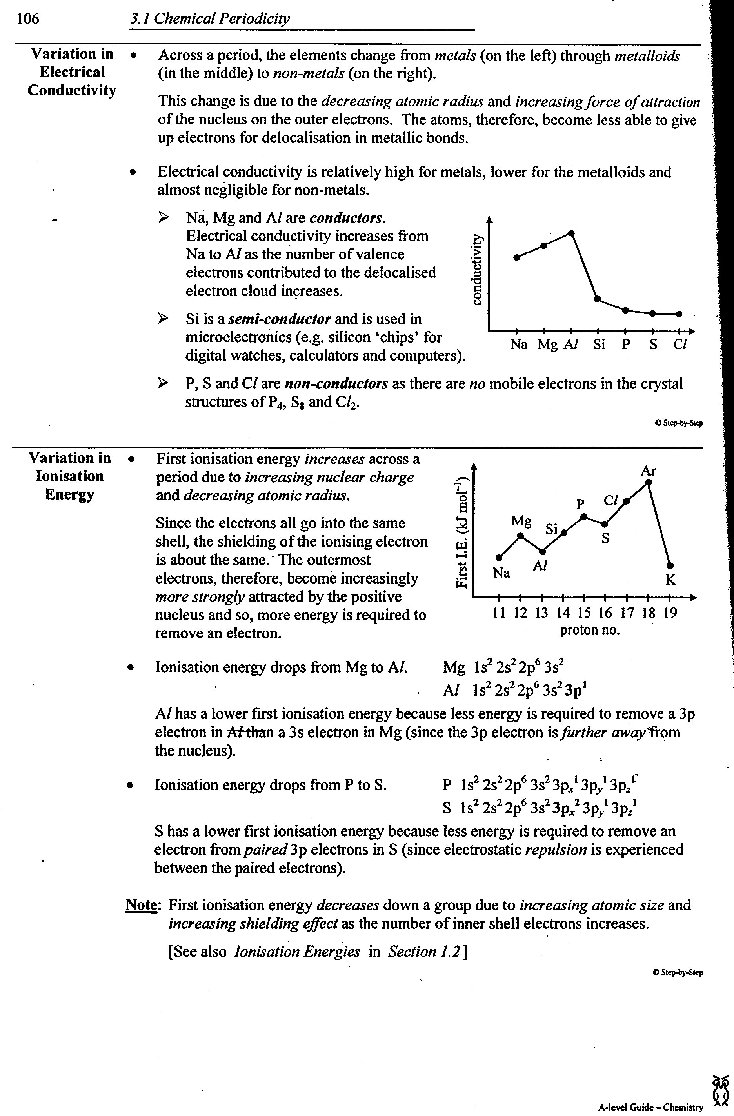
Physical Properties
Variation in Electrical Conductivity
Na, Mg and Al are conductors.
Si is a semi-conductor.
P,S, Cl are non-conductors.

Slide 12
Physical Properties
Variation In Ionisation Energy
First I.E. increases across a period due to increasing nuclear charge and decreasing atomic radius.
Elements from same period experience same shielding effect.
Two special cases:

Slide 13
Physical Properties
Variation In Ionisation Energy

Slide 14
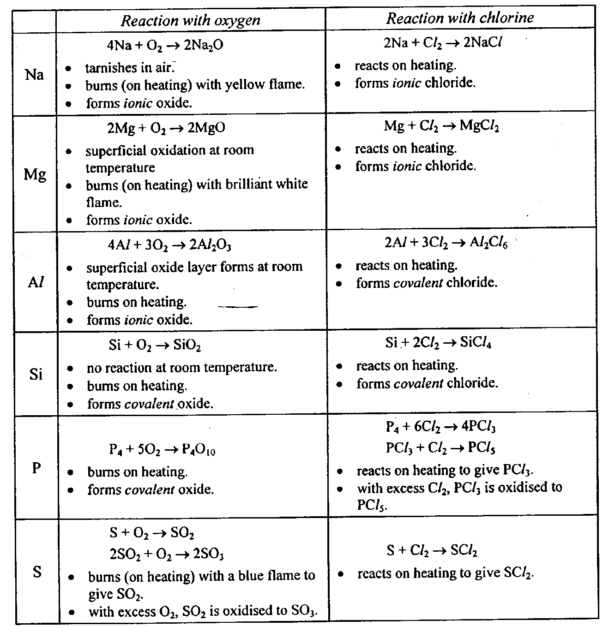
Chemical Properties
Reaction with O₂ and Cl₂

Slide 15
Chemical Properties
Variation In Oxidation Number
The oxidation number of an element in its oxide and chloride corresponds to the number of electrons used for bonding and it is always positive.
The maximum oxidation number is the same as its group number.
P and S show several oxidation numbers because they can expand their octet. Hence, the oxidation number depends on the number of electrons used for bonding.

Slide 16
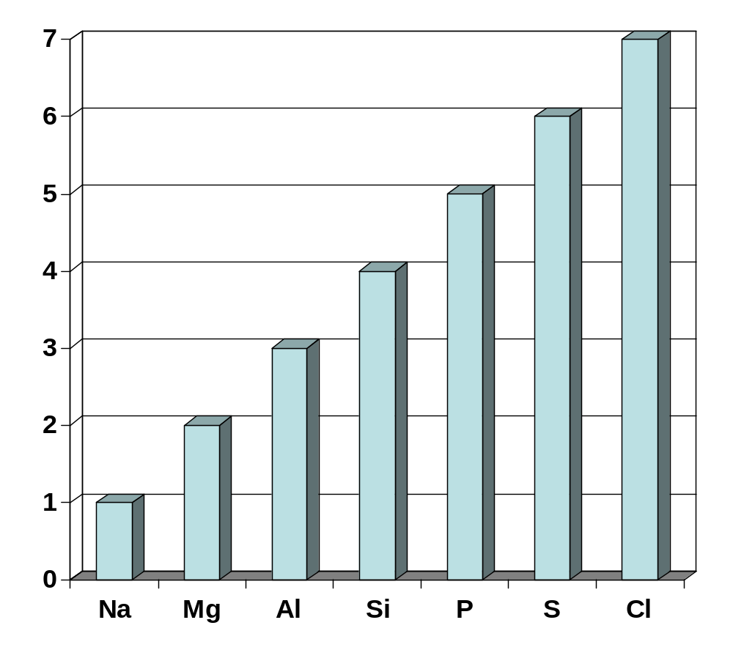
Chemical Properties
Variation In Oxidation Number
Oxidation number
Oxidation number in oxide and chloride
Oxidation number in oxide
Oxidation number in chlorides

Slide 17
Chemical Properties
Oxides of Period 3 Elements
Across the period, the bond character of the oxides changes from ionic to covalent.
Element | Na | Mg | Al | Si | P | S
Atomic No. | 11 | 12 | 13 | 14 | 15 | 16
Formula of chloride | Na₂O | MgO | Al₂O₃ | SiO₂ | P₄O₆ P₂O₁₀ | SO₂ SO₃
Structure | Ionic | Ionic | ionic with covalent character | Macromol-ecular | Molecular | _{Molecular}
Oxidation No. | +1 | +2 | +3 | +4 | +3 +5 | +4 +6

Slide 18
Chemical Properties
Reaction of Oxides with Water
Na₂O dissolves readily in water to give an alkaline solution (pH ~ 13)
Na₂O(s) + H₂O(l) → 2NaOH(aq)
MgO dissolves slightly in water to give a weakly alkaline solution. It is partially soluble because of the stronger ionic bond (dissolves in steam) (~pH 9).
MgO(s) + H₂O(g) ↔ Mg(OH)₂(aq)
Al₂O₃ and SiO₂ do not dissolve in water because they have strong ionic and covalent bond respectively.

Slide 19
Chemical Properties
Reaction of Oxides with Water
P₄O₁₀, SO₂, and SO₃ dissolve readily in water to give acidic solutions. (~pH 2)
P₄O₁₀(s) + 6H₂O(l) → 4H₃PO₄(aq)
SO₂(g) + H₂O(l) → H₂SO₃(aq)
SO₃(g) + H₂O(l) → H₂SO₄(aq)

Slide 20
Chemical Properties
Acid/Base Behaviour of the Oxides
The Acid/Base Behaviour of period 3 oxides changes from basic to amphoteric to acidic.
Na₂O and MgO are basic oxides
Na₂O(s) + 2HCl(aq) → 2NaCl(aq) + H₂O(l)
MgO(s) + 2HCl(aq) → MgCl₂(aq) + H₂O(l)
Al₂O₃ is an amphoteric oxide.
Al₂O₃(s) + 6HCl(aq) → 2AlCl₃(aq) + 3H₂O(l)
Al₂O₃(s) + 2NaOH(aq) + 3H₂O(l) → 2NaAl(OH)₄(aq)

Slide 21
Chemical Properties
Acid/Base Behaviour of the Oxides
SiO₂ is acidic oxide.It does not react with aqueous NaOH. It reacts only with concentrated NaOH.
SiO₂(s) + 2NaOH(aq) → Na₂SiO₃(s) + H₂O(l)
P₄O₁₀, SO₂, and SO₃ are acidic oxides
P₄O₁₀ + 12NaOH → 4Na₃PO₄ + 6H₂O
SO₂ + 2NaOH → Na₂SO₃ + H₂O
SO₃ + 2NaOH → Na₂SO₄ + H₂O

Slide 22
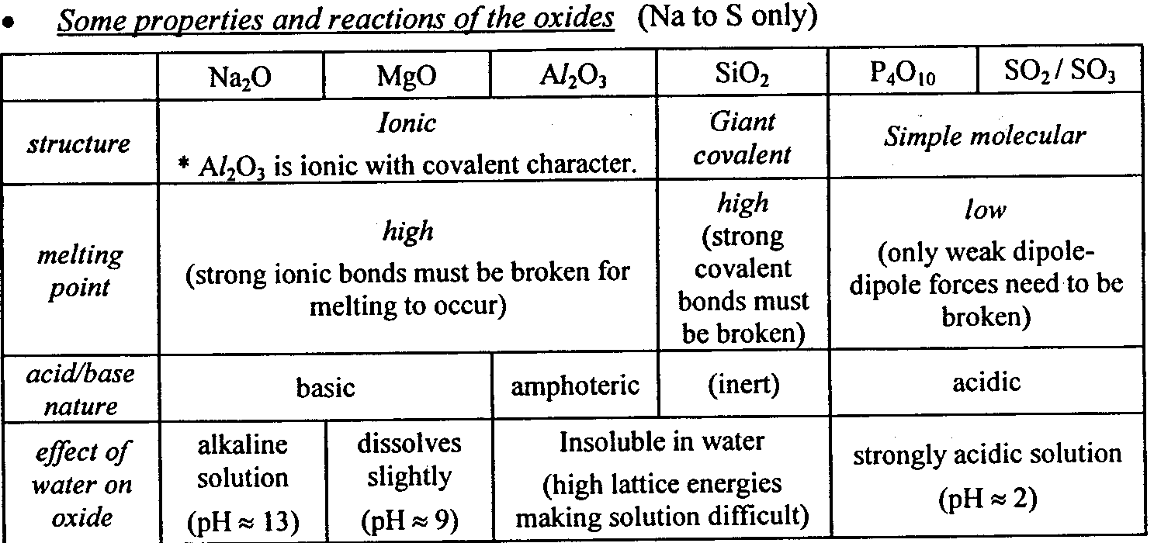
Summary of Period 3 Oxides

Slide 23
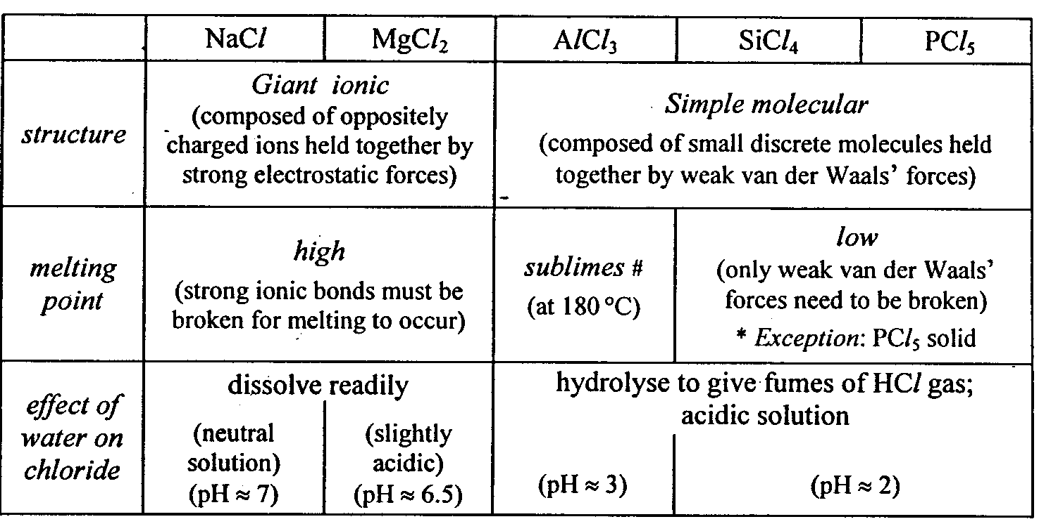
Chlorides of Period 3 Elements

Slide 24
Chemical Properties
Reactions of Chlorides with Water
NaCl dissolves in water to give a neutral solution (pH 7)
NaCl(s) → Na⁺(aq) + Cl⁻(aq)
MgCl₂ dissolves in water with slight hydrolysis to give a slightly acidic solution (pH 6.5)
MgCl₂(s) + aq → [Mg(H₂O)₆]²⁺(aq) + 2Cl⁻(aq)
[Mg(H₂O)₆]²⁺ [Mg(H₂O)₅(OH)]⁺ + H⁺

Slide 25
Chemical Properties
Reactions of Chlorides with Water
AlCl₃ dissolves in water with hydrolysis to give an acidic solution ( pH ~ 3)
AlCl₃(s) + aq → [Al(H₂O)₆]³⁺(aq) + 3Cl⁻(aq)
[Al(H₂O)₆]³⁺ → [Al(H₂O)₅(OH)]²⁺ + H⁺
SiCl₄ and PCl₅ undergoes complete hydrolysis in water to give strongly acidic solutions (pH ~ 2)
SiCl₄ + 2H₂O → SiO₂ + 4HCl
PCl₅ + 4H₂O → H₃PO₄ + 5HCl

